Slide 1
E-R Diagram

Slide 2
What is the ER Model?
The ER or (Entity Relational Model) is a high-level conceptual data model diagram.
Entity-Relation model is based on the notion of real-world entities and the relationship between them.

Slide 3
ER modeling helps you to analyze data requirements systematically to produce a well-designed database.
So, it is considered a best practice to complete ER modeling before implementing your database.

Slide 4
History of ER models
ER diagrams are a visual tool which is helpful to represent the ER model.
It was proposed by Peter Chen in 1971 to create a uniform convention which can be used for relational database and network. He aimed to use an ER model as a conceptual modeling approach.

Slide 5
What is ER Diagrams?
Entity relationship diagram displays the relationships of entity set stored in a database. In other words, we can say that ER diagrams help you to explain the logical structure of databases.
At first look, an ER diagram looks very similar to the flowchart. However, ER Diagram includes many specialized symbols, and its meanings make this model unique.

Slide 6
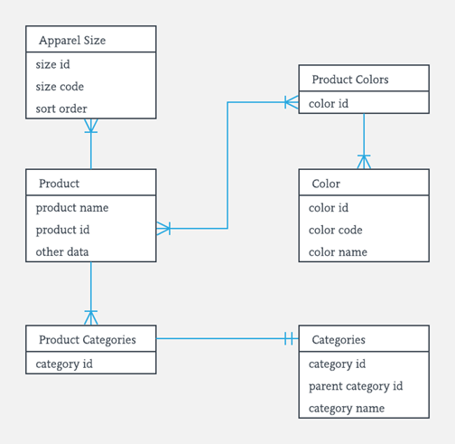

Slide 7
Facts about ER Diagram Model
ER model allows you to draw Database Design
It is an easy to use graphical tool for modeling data
Widely used in Database Design
It is a GUI representation of the logical structure of a Database
It helps you to identifies the entities which exist in a system and the relationships between those entities

Slide 8
Why use ER Diagrams?
Helps you to define terms related to entity relationship modeling
Provide a preview of how all your tables should connect, what fields are going to be on each table
Helps to describe entities, attributes, relationships
ER diagrams are translatable into relational tables which allows you to build databases quickly
ER diagrams can be used by database designers as a blueprint for implementing data in specific software applications
The database designer gains a better understanding of the information to be contained in the database with the help of ERP diagram
ERD is allowed you to communicate with the logical structure of the database to users

Slide 9
Components of the ER Diagram
Entities
Attributes
Relationships

Slide 10
Example
For example, in a University database, we might have entities for Students, Courses, and Lecturers. Students entity can have attributes like Rollno, Name, and DeptID. They might have relationships with Courses and Lecturers.

Slide 11
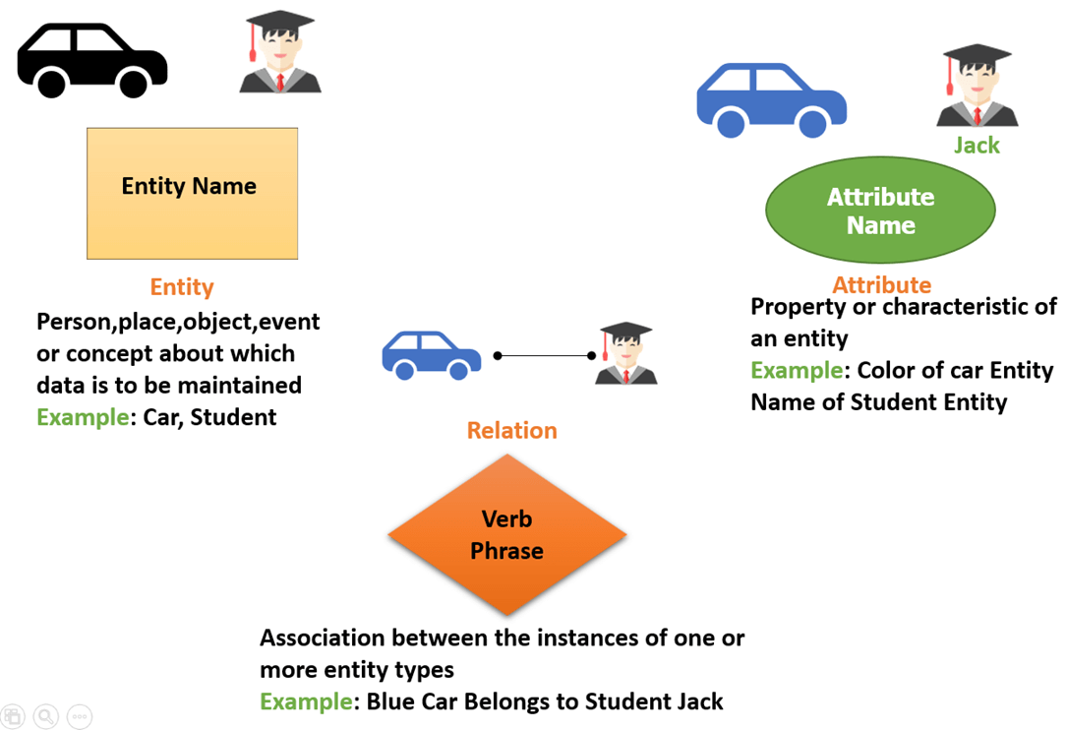

Slide 12
WHAT IS ENTITY?
A real-world thing either living or non-living that is easily recognizable and non recognizable.
It is anything in the enterprise that is to be represented in our database. It may be a physical thing or simply a fact about the enterprise or an event that happens in the real world.

Slide 13
An entity can be place, person, object, event or a concept, which stores data in the database.
The characteristics of entities are must have an attribute, and a unique key. Every entity is made up of some 'attributes' which represent that entity.

Slide 14
Examples of entities
Person: Employee, Student, Patient
Place: Store, Building
Object: Machine, product, and Car
Event: Sale, Registration, Renewal
Concept: Account, Course

Slide 15
Notation of an Entity
Entity set:
Student
An entity set is a group of similar kind of entities. It may contain entities with attribute sharing similar values. Entities are represented by their properties, which also called attributes.
All attributes have their separate values. For example, a student entity may have a name, age, class, as attributes.

Slide 16
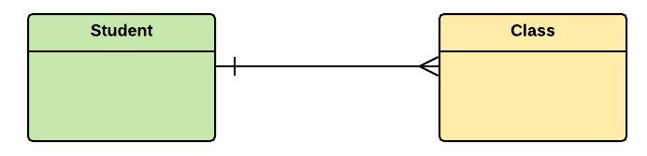

Slide 17
Example of Entities
A university may have some departments. All these departments employ various lecturers and offer several programs.
Some courses make up each program. Students register in a particular program and enroll in various courses. A lecturer from the specific department takes each course, and each lecturer teaches a various group of students.

Slide 18
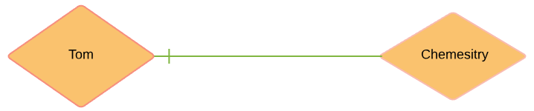
Relationship
Relationship is nothing but an association among two or more entities. E.g., Tom works in the Chemistry department.
Entities take part in relationships. We can often identify relationships with verbs or verb phrases.

Slide 19
For example
You are attending this lecture
I am giving the lecture
Just loke entities, we can classify relationships according to relationship-types:
A student attends a lecture
A lecturer is giving a lecture.

Slide 20
Weak Entities
A weak entity is a type of entity which doesn't have its key attribute. It can be identified uniquely by considering the primary key of another entity. For that, weak entity sets need to have participation.

Slide 21
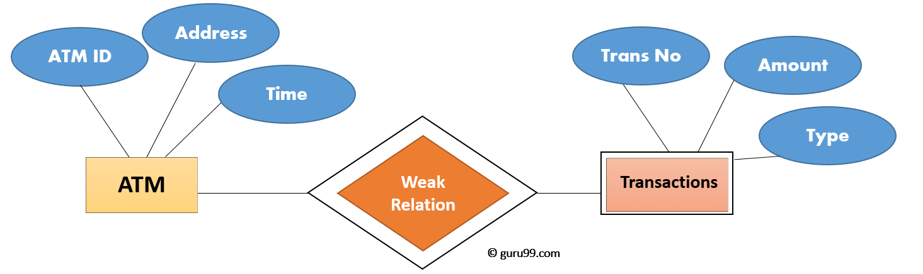
In above example, "Trans No" is a discriminator within a group of transactions in an ATM.

Slide 22
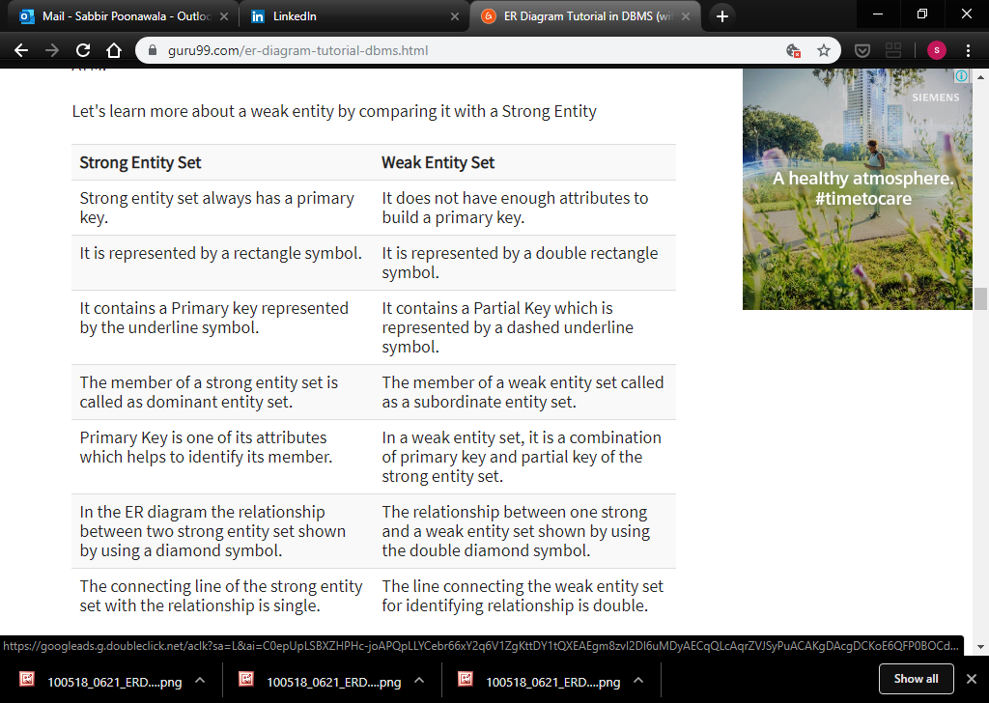

Slide 23
Attributes
It is a single-valued property of either an entity-type or a relationship-type.
For example, a lecture might have attributes: time, date, duration, place, etc.
An attribute is represented by an Ellipse

Slide 24
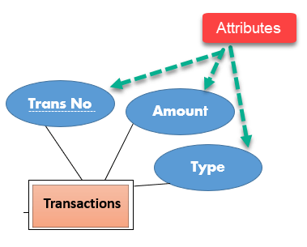

Slide 25
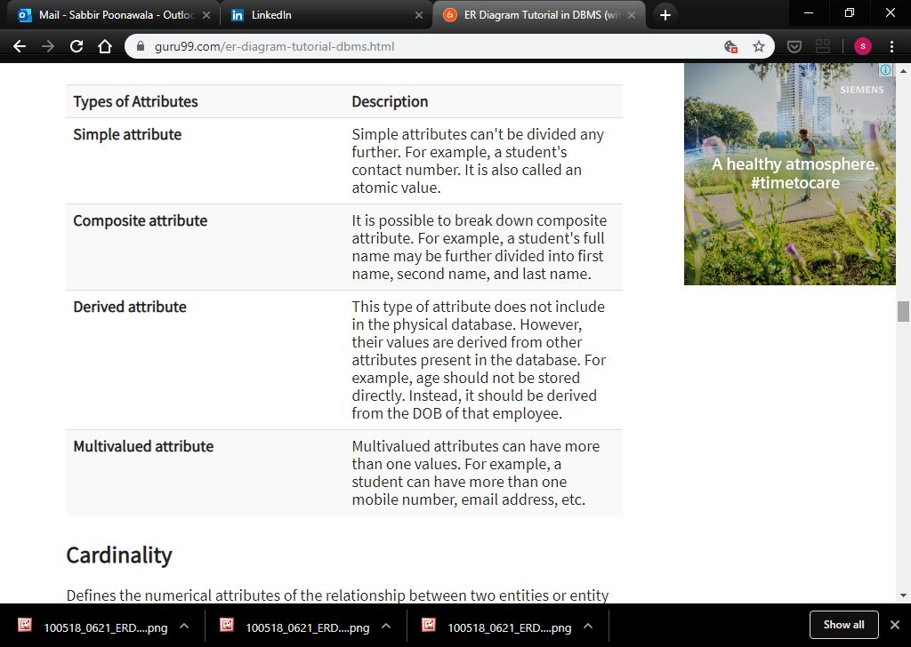

Slide 26
Cardinality
Defines the numerical attributes of the relationship between two entities or entity sets.
Different types of cardinal relationships are:
One-to-One Relationships
One-to-Many Relationships
May to One Relationships
Many-to-Many Relationships

Slide 27
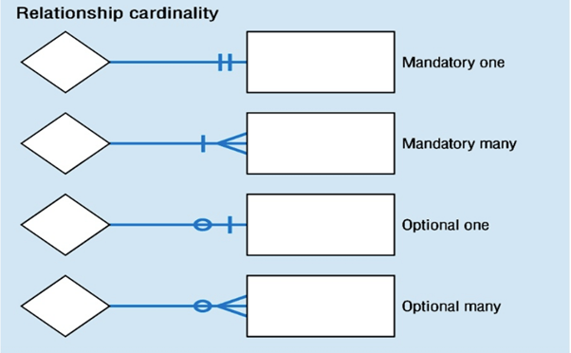

Slide 28
1.One-to-one:
One entity from entity set X can be associated with at most one entity of entity set Y and vice versa.
Example: One student can register for numerous courses. However, all those courses have a single line back to that one student.

Slide 29
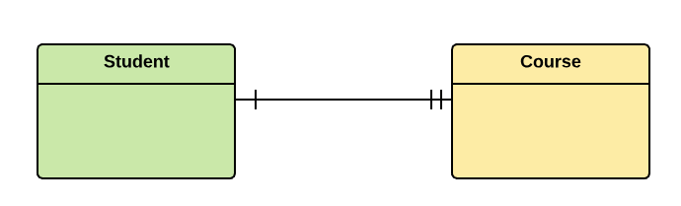

Slide 30
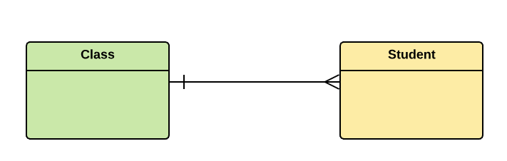
2.One-to-many
One entity from entity set X can be associated with multiple entities of entity set Y, but an entity from entity set Y can be associated with at least one entity.
For example, one class is consisting of multiple students.

Slide 31
3. Many to One
More than one entity from entity set X can be associated with at most one entity of entity set Y. However, an entity from entity set Y may or may not be associated with more than one entity from entity set X.

Slide 32
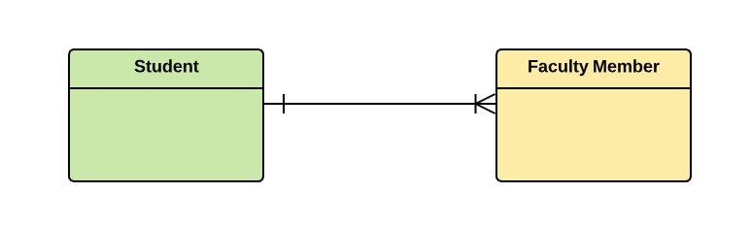
4. Many to Many:
One entity from X can be associated with more than one entity from Y and vice versa.
For example, Students as a group are associated with multiple faculty members, and faculty members can be associated with multiple students.

Slide 33
ER- Diagram Notations
Rectangles: This symbol represent entity types
Ellipses : Symbol represent attributes
Diamonds: This symbol represents relationship types
Lines: It links attributes to entity types and entity types with other relationship types
Primary key: attributes are underlined
Double Ellipses: Represent multi-valued attributes

Slide 34
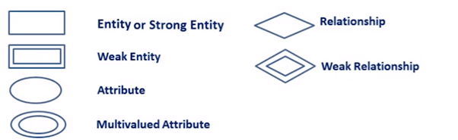

Slide 35

Steps to Create an ERD

Slide 36
Let's study them with an example:
In a university, a Student enrolls in Courses. A student must be assigned to at least one or more Courses. Each course is taught by a single Professor. To maintain instruction quality, a Professor can deliver only one course

Slide 37
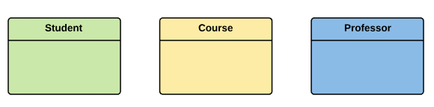
Step 1) Entity Identification
We have three entities
Student
Course
Professor

Slide 38
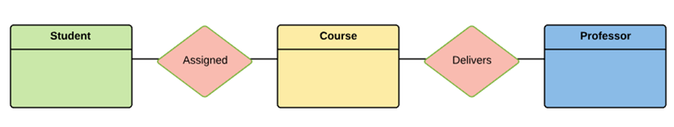
Step 2) Relationship Identification
We have the following two relationships
The student is assigned a course
Professor delivers a course

Slide 39
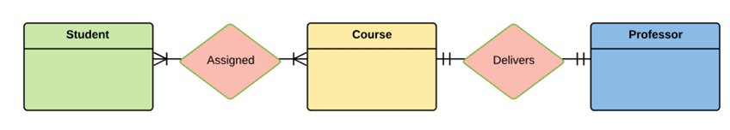
Step 3) Cardinality Identification
For them problem statement we know that,
A student can be assigned multiple courses
A Professor can deliver only one course

Slide 40
Step 4) Identify Attributes
You need to study the files, forms, reports, data currently maintained by the organization to identify attributes. You can also conduct interviews with various stakeholders to identify entities.
Initially, it's important to identify the attributes without mapping them to a particular entity.

Slide 41
Once, you have a list of Attributes, you need to map them to the identified entities. Ensure an attribute is to be paired with exactly one entity. If you think an attribute should belong to more than one entity, use a modifier to make it unique.
Once the mapping is done, identify the primary Keys. If a unique key is not readily available, create one.

Slide 42
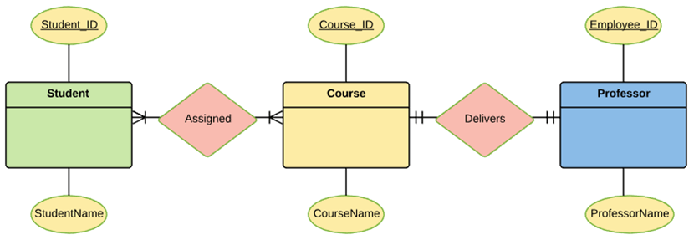

Slide 43
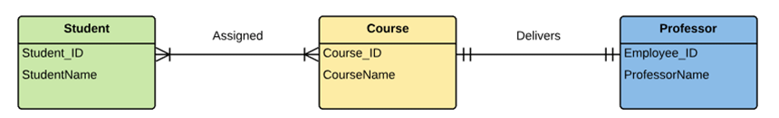
Step 5) Create the ERD
A more modern representation of ERD Diagram

Slide 44
Best Practices for Developing Effective ER Diagrams
Eliminate any redundant entities or relationships
You need to make sure that all your entities and relationships are properly labeled
There may be various valid approaches to an ER diagram. You need to make sure that the ER diagram supports all the data you need to store
You should assure that each entity only appears a single time in the ER diagram
Name every relationship, entity, and attribute are represented on your diagram
Never connect relationships to each other
You should use colors to highlight important portions of the ER diagram

